Slide 1







OAuth 2.0 Redirect URI Validation Falls Short, Literally
Tommaso Innocenti, Matteo Golinelli, Kaan Onarlioglu,
Ali Mirheidari, Bruno Crispo, and Engin Kirda
innocenti.t@northeastern.edu

Slide 2


Tommaso Innocenti
PhD candidate
@Northeastern University
(Boston)
innotommy.com

Slide 3

-XSS style
-HTML injection
-Open redirect
-OAuth token Leakage
RFC redirect_uri validation issue
Full victim’s account takeover

Slide 4
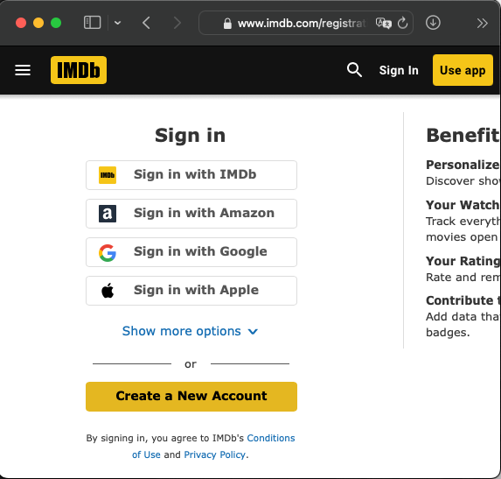




What the heck is OAuth 2.0?
Introduction
Bob
Service Provider
Identity Provider
Visits Website
Login Request
User Authentication and Consent
Login Response
"Hi, Bob!"
Notes:
What is OAuth at higher level and the interaction of the 3 main actors the Client the resource owner and the authorization server IDP in our scheme
Facilitate login in sites usually Authorization code grant

Slide 5
Code grant flow
Notes:
Code grant is the focus of our talk the three-legged protocol. Redirect_uri defines the browser flow and for this reason has been targeted by attacker and researchers and this has been the primary focus of BCP where it hold a primary position.

Slide 6
RFC6749 & RFC3986
redirect_uri validation in RFC:
RFC 6749 Section 3.1.2.3
The authorization server MUST compare the two URIs using simple string comparison as defined in RFC 3986 Section 6.2.1.
RFC 3986 Section 6.2.1
Testing strings for equality is normally based on pair comparison of the characters that make up the strings, starting from the first and proceeding until both strings are exhausted, and all characters are found to be equal, until a pair of characters compares unequal, or until one of the strings is exhausted before the other.
Notes:
Present the redirect_uri validation in RFC showing that different length of redirect_uri are allowed posing a security risk

Slide 7




What is Path Confusion?
Path Confusion
Bob
Service Provider
Identity Provider
Visits Website
PathConfusion:
/..%252FFAKEPATH
/%252e%252e%252FFAKEPATH
Login Request
User Authentication and Consent
Login Response
Notes:
Define what is path confusion and what this confusion can generate in the OAuth protocol by presenting our Path confusion primer to verify IdPs validation of redirect_uri

Slide 8
Methodology

Slide 9
Results
6/16 IdPs vulnerable to Path Confusion
(Facebook, Microsoft, GitHub, Atlassian, NAVER, and VK)
Notes:
Path confusion redirects to unintend path but not immediate menace for users
OPP in contrary creates confusion allowing attacker to mislead Client sites to authenticate the victim as the attackers

Slide 10
Are we doomed?
Notes:
Where we attack and how it increase the attack surface removing the race condition.
1) OPP leave OAuth parameters unused and vulnerable to leakage which RFC6749 section 3.1.2.5 warns about including third party in endpoint, we confirm that it still a common problem among Clients.
2) Now all the Client vulnerability become actionable leakage as well as other vulnerability which thanks to the race removal could escalates
Although a final defence is in place in Access token request

Slide 11
Impact
redirect_uri validation in redeem step
RFC 6749 Section 4.1.3
The Client makes a request to the token endpoint by sending the following parameters[...] redirect_uri REQUIRED, if the "redirect_uri" parameter was included in the authorization request as described in Section 4.1.1, and their values MUST be identical.
Will IdPs use the same vulnerable validation procedure?
2/16 IdPs are vulnerable (Naver, GitHub)
Notes:
Idp must check redirect_uri

Slide 12
Path Confusion
-XSS style
-HTML injection
-Open redirect
-OAuth token Leakage
RFC redirect_uri validation issue
Redirect_uri validation in
redeem step
Full victim’s account takeover

Slide 13

Attack scenario
Path Confusion
Attack checklist:
1)Vulnerable redirect_uri parsing in Authorization step
→6/16 IdPs
2)Vulnerable Client
→ openbugbounty.com
3)Vulnerable redirect_uri check in redeem step
→ 2/16 IdPs
Attack URL:
https://nid.naver.com/oauth2.0/authorize?client_id=<REDACTED>&response_type=code&redirect_uri=https%3A%2F%2F<REDACTED>%2Fopenapi%2Fsocial%2Flogin.php/%252e%252e/%252e%252e/%252e%252e/redirect.php%3Ftarget%3Dhttps%3a%2F%2F<attacker-domain>%2F&state=random-state
Full Victim’s account takeover is possible!!!
Notes:
Vulnerability disclosed 2018 becomes actionable enabling the attacker to perform an account takeover.

Slide 14
Responsible Disclosure
All IdPs involved in the study which has been found vulnerable has been contacted.
Microsoft acknowledge our report and fixed their validation procedure.
GitHub is tracking internally the problem and is actively working on a fix
We are actively working with Naver to help fixing the issue
Reported our findings to the OAuth working group, which included our recommendation in the BCP.
OpenID foundation modified the conformance test suite to include our attack
Notes:
Vulnerability disclosed 2018 becomes actionable enabling the attacker to perform an account takeover.

Slide 15
Takeaways
Current “best practice” is not good enough
Recommendations:
1) redirect_uri validation should use strict string equality check
2) IdPs server should never sanitize redirect_uri to avoid introducing any discrepancy, instead should validate them
Notes:
What we identified are not bug but problem rooted in the RFC specification language which doesn’t account for new threat like PathConfusion
Redirect_uri must be of equal size and identical byte sequence
Observing code or state in redirect_uri is a clear indication of an attack or a namespacing problem of the Client

Slide 16
One more thing
Path confusion
OAuth Parameter Pollution →10/16 IdPs vulnerable

Slide 17
Q&A
Questions?

Slide 18
RFC6749 & RFC3986
redirect_uri parameter in RFC:
RFC 6749 Section 3.1
The endpoint URI MAY include an "application/x-www-form-urlencoded" formatted (per Appendix B) query component (RFC 3986 Section 3.4), which MUST be retained when adding additional query parameters.
RFC 6749 Section 10.14
A code injection attack occurs when an input or otherwise external variable is used by an application unsanitized and causes modification to the application logic. This may allow an attacker to access the application device or its data, cause a denial of service, or introduce a wide range of malicious side effects. The authorization server and Client MUST sanitize (and validate when possible) any value received–in particular, the value of the "state" and "redirect_uri” parameters.
Lack on input validation directive or attack prevention
Notes:
Lack of directive allows the poisoning of the redirect_uri parameters including code and state values

Slide 19
OAuth Parameter Pollution
Attack URL:
https://idp.example.com/oauth/authorize?response_type=code&client_id =<validID>&state=<value>&redirect_uri=https://Client.example.com/oauth/callback
%3Fcode%3D<value>
Victim’s authenticated as the attacker!!

Slide 20
One more recommendation
Path confusion
OAuth Parameter Pollution →10/16 IdPs vulnerable
Recommendations:
3) IdPs should validate redirect_uri and block Authorization request where Code or state parameters are included in the redirect_uri as parameter.

Slide 21
Q&A
Questions?

